Slide 1
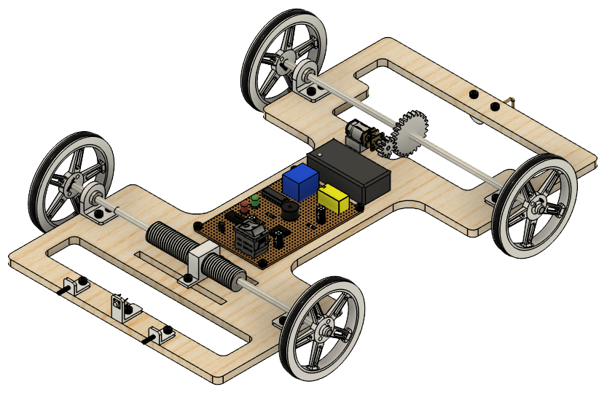
IMechE Scenario 1: Design Review
Rishit Madireddy, Rohan Karanth, Naren Muruganantham, Yash Sharma, Krist Gao

Slide 2
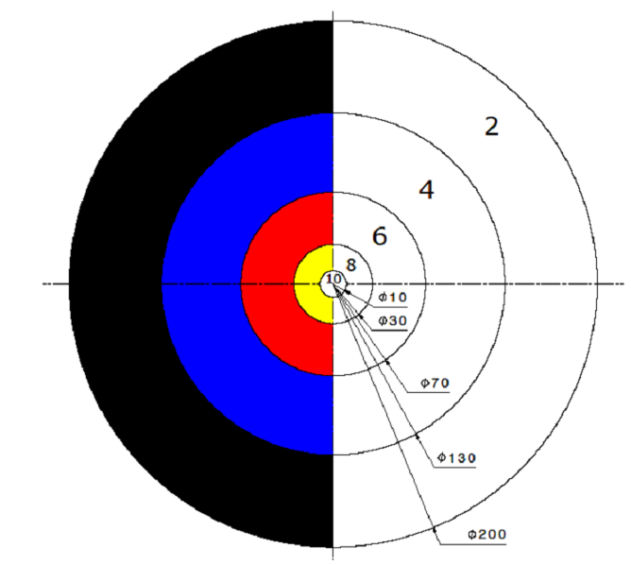
Project Brief
Objective
Design, build & test an autonomous mechanical device to simulate EV charging.
Engage with a vertical charging port simulator (50mm height) & return to start bullseye.
Travel a maximum of 8m within 3 minutes on a 1m-wide track
Specification
Device must be smaller than 400mm x 400mm x 400mm.
No programmable electronics – only analog circuits & mechanical designs
Budget of £50
Goals
Centre of mass within 20mm of the centre in all dimensions
Speed between 0.05 and 0.1 m/s.

Slide 3
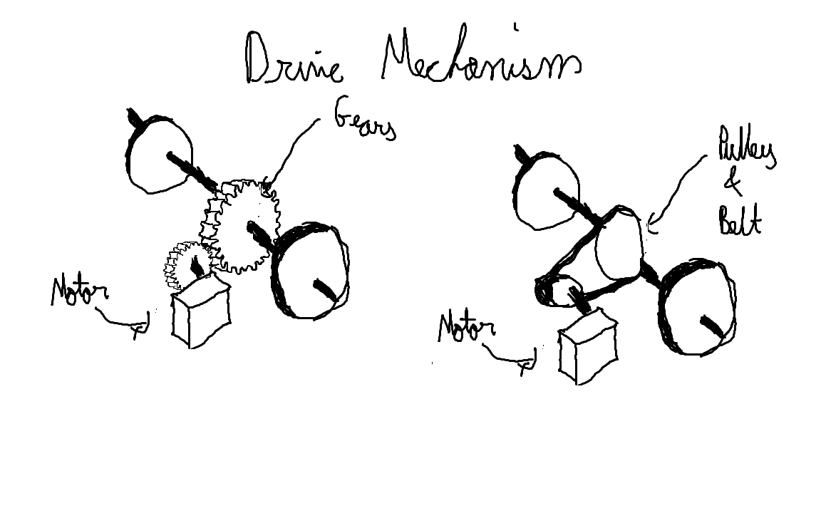
Initial Ideas

Slide 4
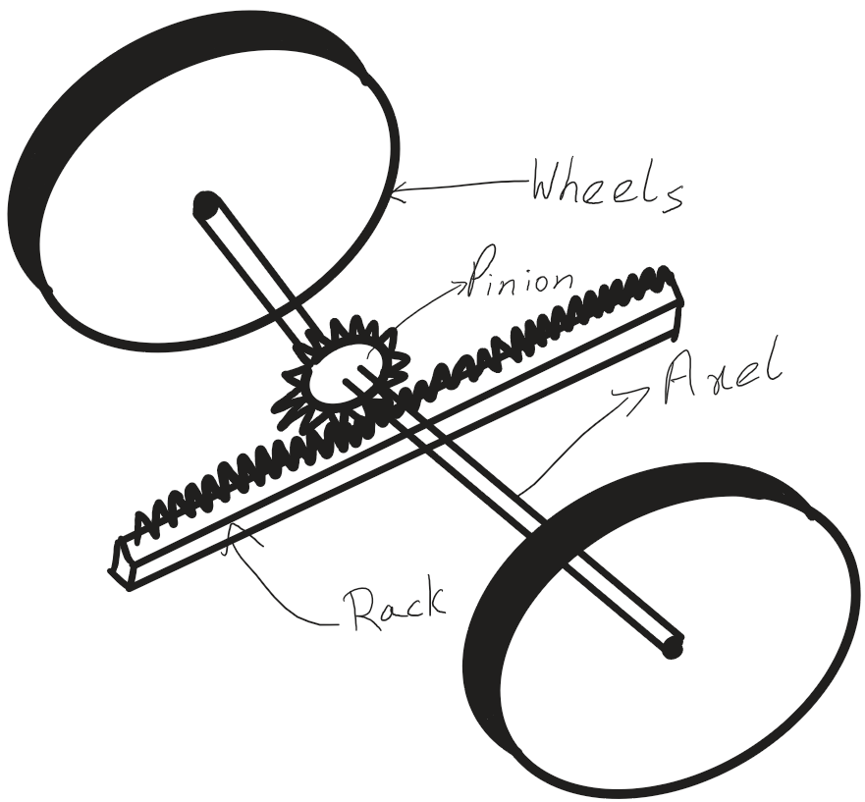
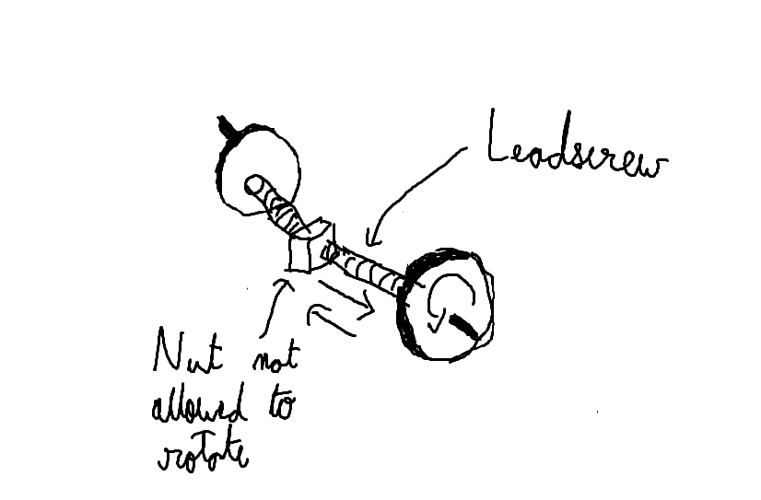
Initial Ideas

Slide 5
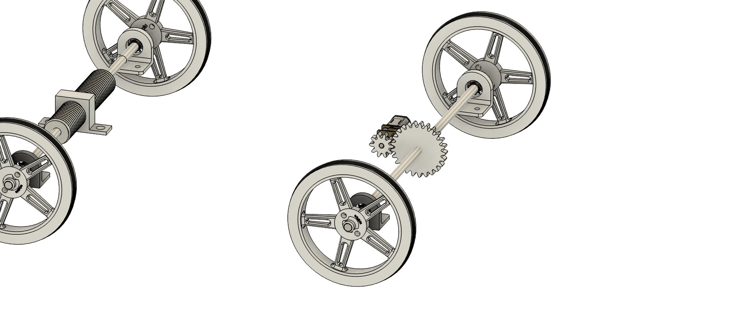
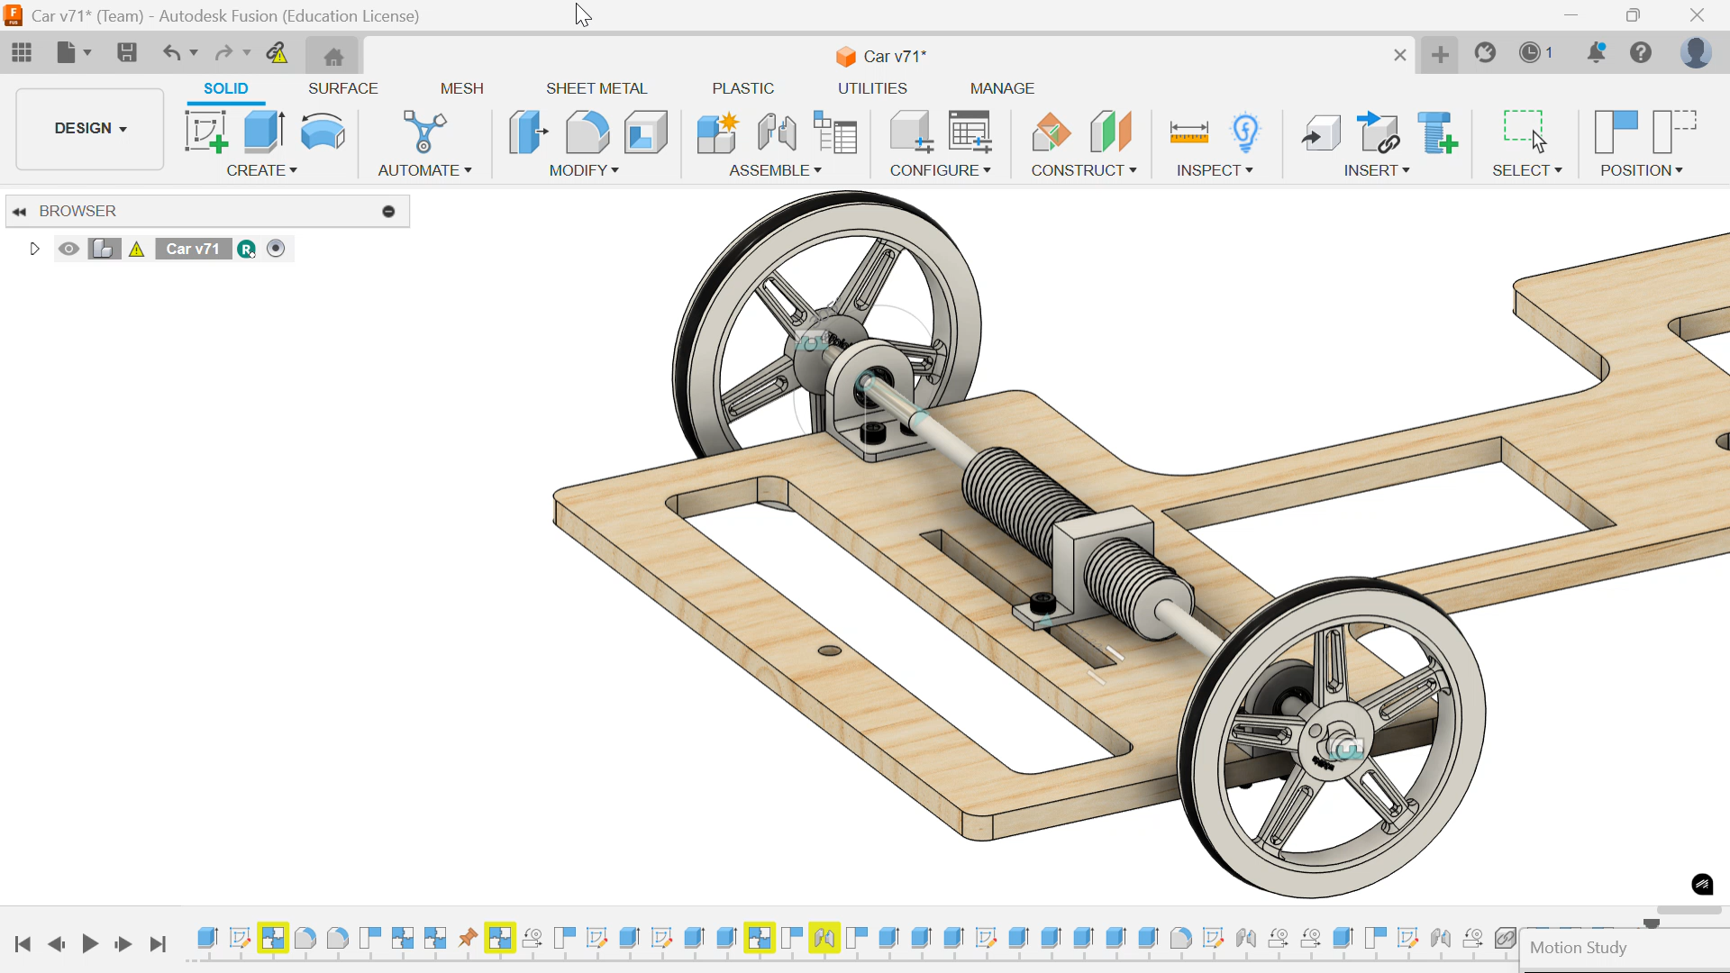
Design Animated
Key Features
- Gear Ratio of 1:2.5
- Lead Screw
- 32 RPM Motor

Slide 6
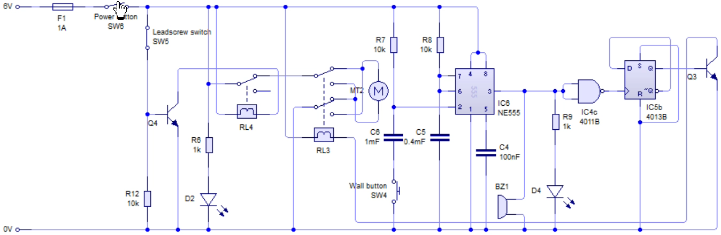
Circuit

Slide 7
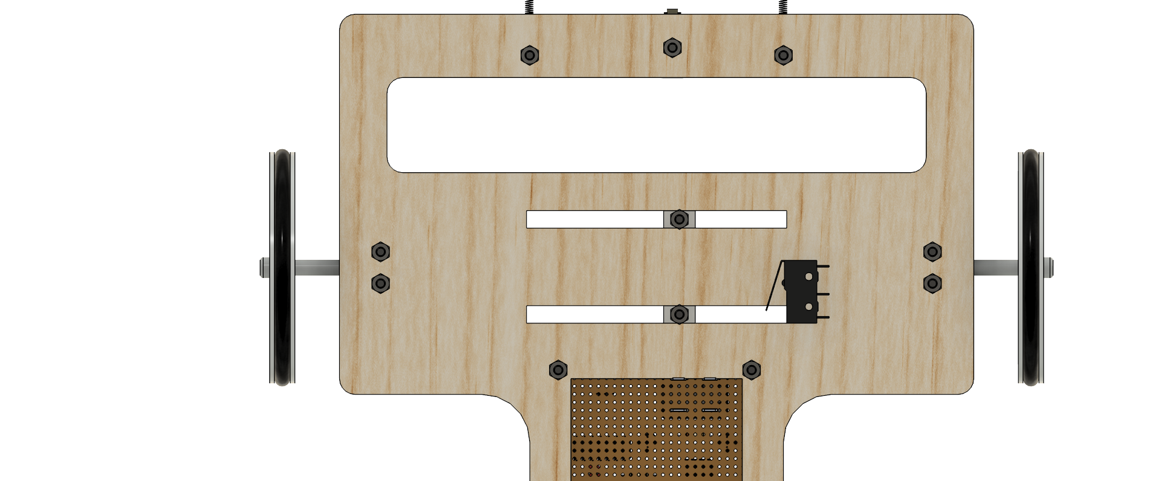
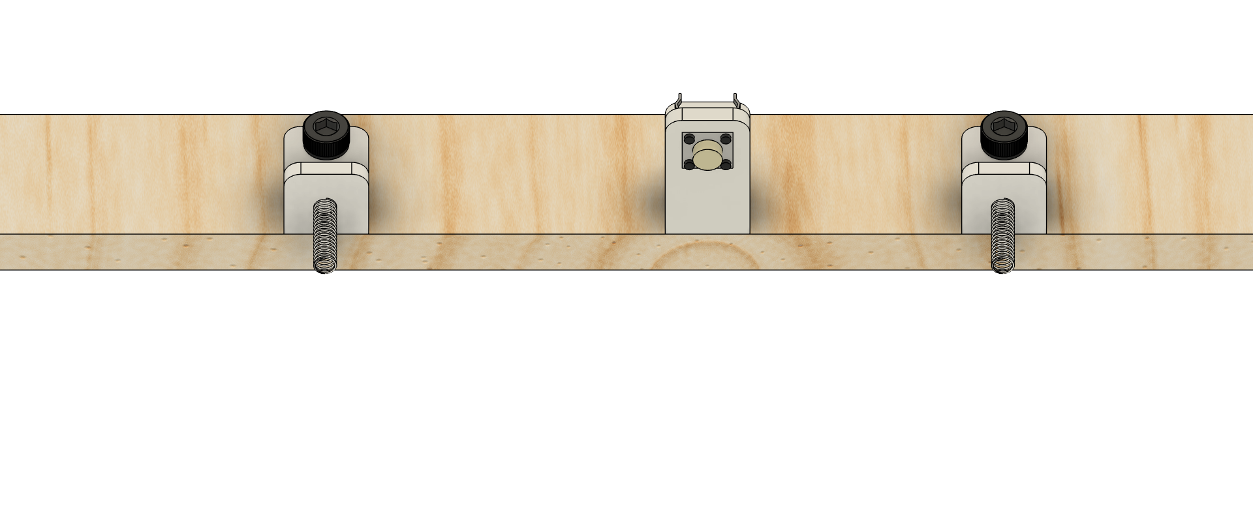
Time delay & Stop
Limit switch on bottom of leadscrew nut
6mm push to make switch used for wall
Monostable ensures 12s delay
Falling-edge triggered flip flop reverses motor polarity after delay

Slide 8
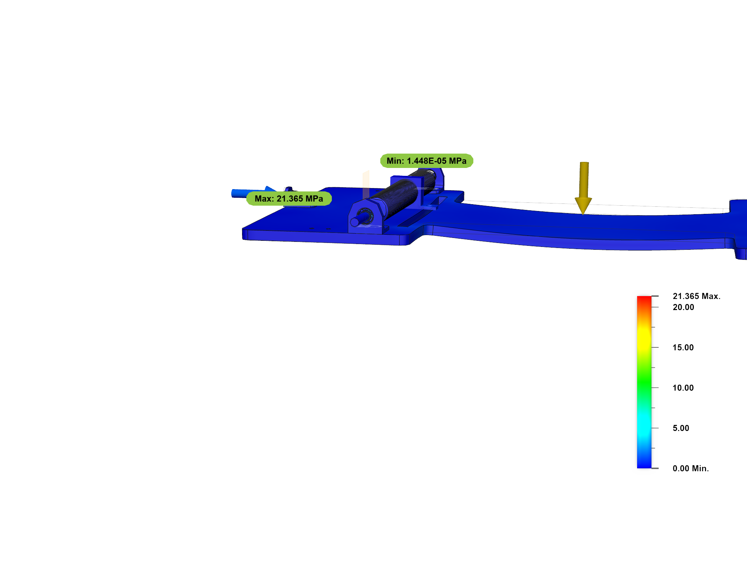
FEA Analysis
Stress

Slide 9
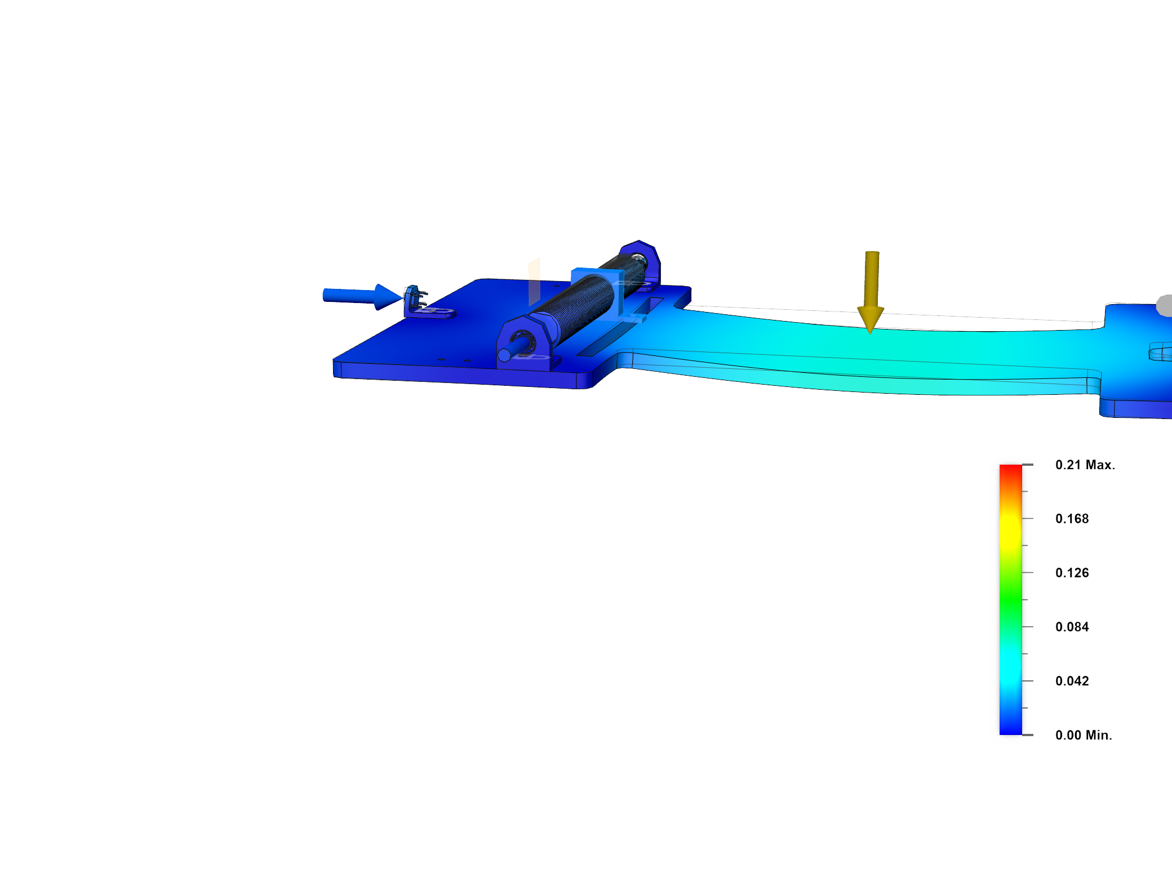
FEA Analysis
Displacement

Slide 10
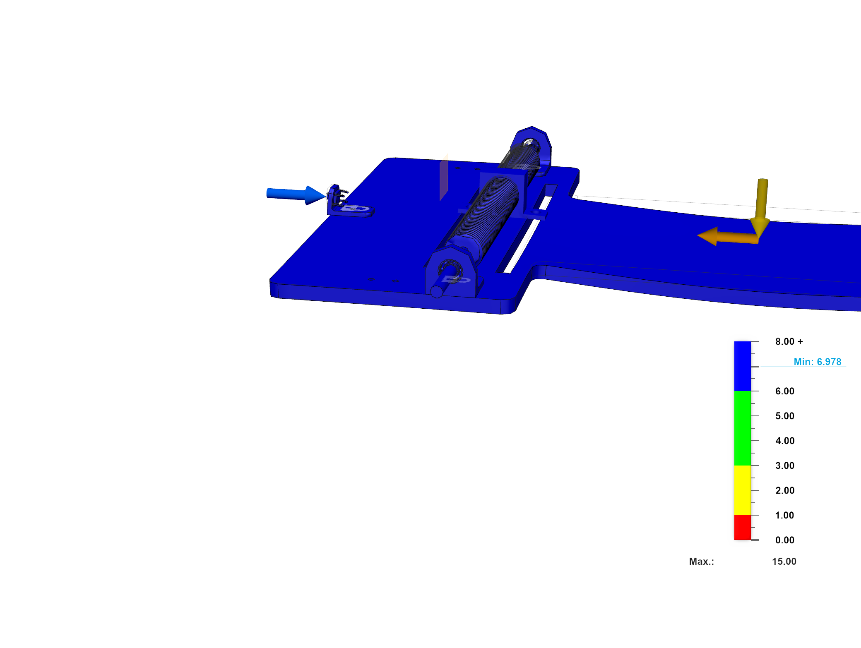
FEA Analysis
Safety Factor

Slide 11
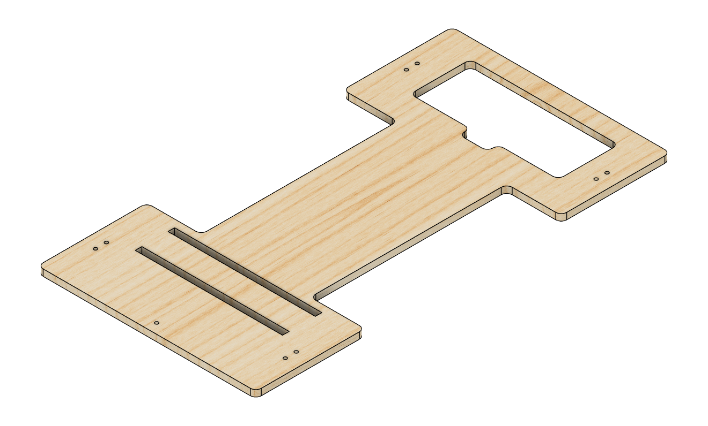
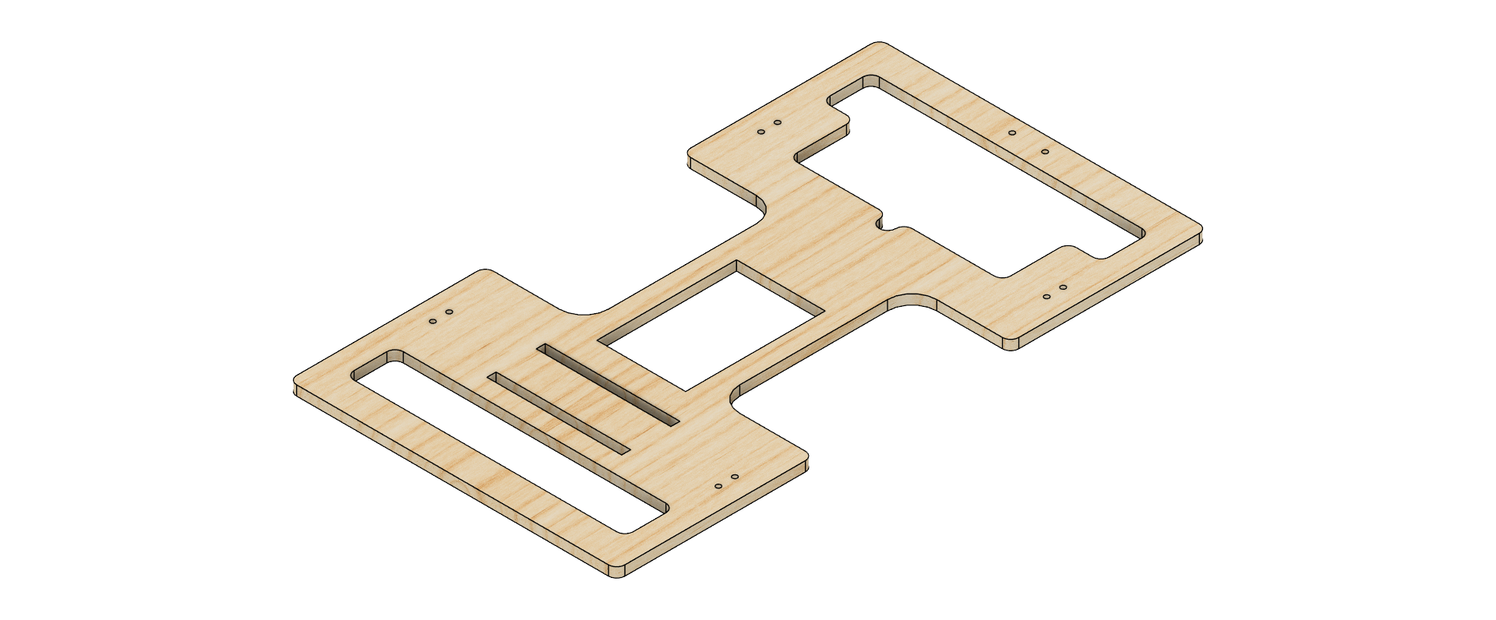
Modified Frame

Slide 12
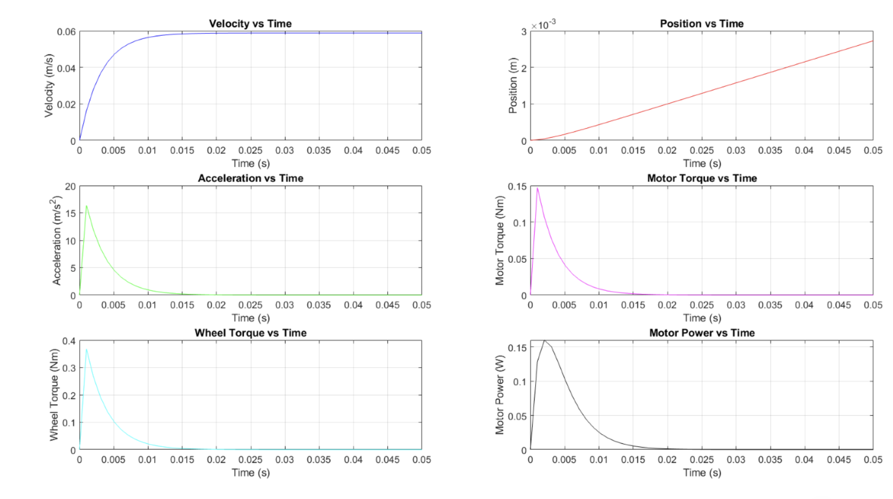
Numerical Model
Maximum acceleration in terms of g: 0.5331g
Maximum speed: 0.0588m/s

Slide 13
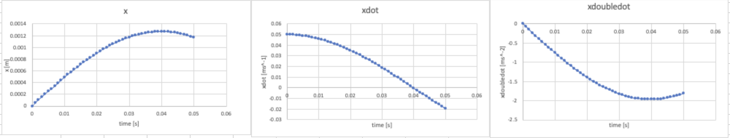
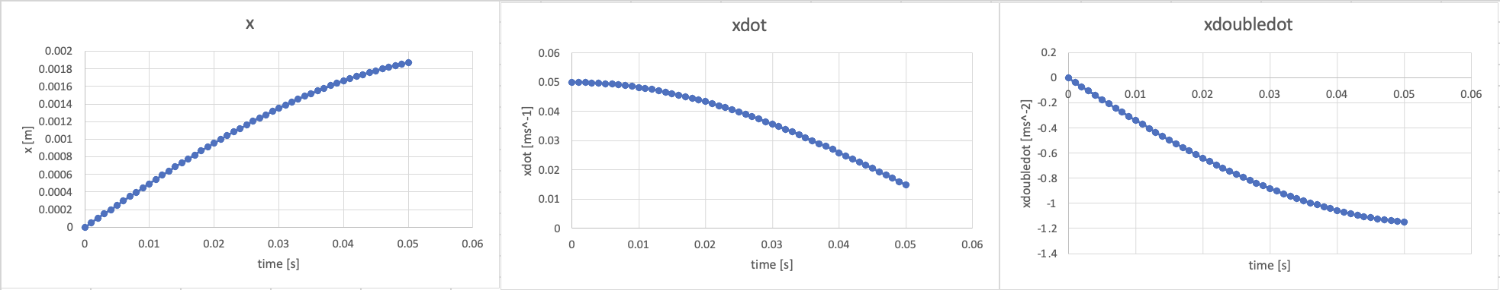
Numerical Model
Non-Driven spring:
-0.0320g
Driven spring:
-0.201g

Slide 14
Cost
Electronics
-Relay
-Timer
-Motor
-LEDs
-Resistors
-Capacitors
-Battery
-Buzzer
- Fuse
Drivetrain
- Bearings
- Axles
- O Rings
- Shaft Collars
Self-Produced
-Wheels
-Datum Mount
-Gears
-Axle Mount
-Leadscrew
-Base
-Switch Mount
£14.40
£19.34
£1.38
Total: £35.12

Slide 15
Thank You

